Slide 1
Introduction to machine learning
Data Preparation and Feature Engineering
R. Brooks

Slide 2
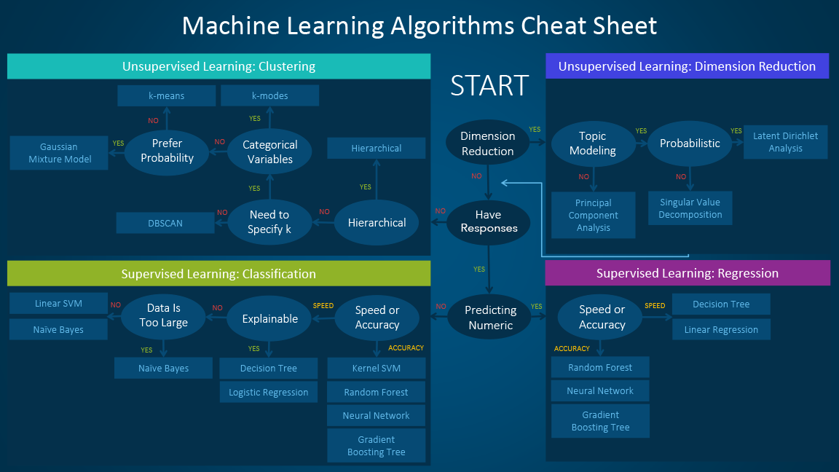

Slide 3
















Process Model for ML
Three main steps
Step 1: Select Data
Step 2: Preprocess Data Step 3: Transform Data
Test data
Model requirements
Metrics
Raw data
Training data
Predictions
Trained model
Requirements
Data
Data
Predictive
Evaluation
Deployment
Analysis
Acquisition
Preparation
Modelling
Icons made by Smashicons from www.flaticon.com
Business metrics
Acceptance criteria
Data protection
Ethics
Interpretability requirements
Exploration
Quality assessment
Cleansing
Labeling
Imputation
Feature engineering
Algorithm selection
Feature selection
Model training
Hyperparameter tuning
Model selection
Evaluation Metrics
Inspection
Interpretation
Manual evaluation
Model compression
Model versioning
Process integration
Monitoring
Online learning
Data collection
ETL
Data integration
De-identification
Feedback
Roles
Data Scientist
Domain Expert
(Data) Engineer

Slide 4
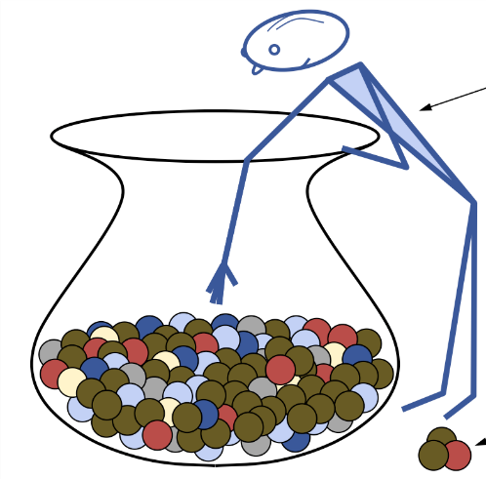
Select Data
Step 1: Select Data
Step 2: Preprocess Data Step 3: Transform Data
There is always a strong desire for including all data that is available, that the maxim “more is better” will hold. This may or may not be true
Consider what data you actually need to address the question or problem you are working on
Questions to help you think:
¡ What is the extent of the data you have available?
¡ What data is not available that you wish you had available?
¡ What data don’t you need to address the problem?
http://uniquerecall.com/

Slide 5
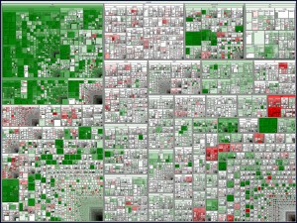
Better Data > Fancier Algorithms
Step 1: Select Data Step 2: Preprocess Data Step 3: Transform Data
Formatting: Selected data may not be in a suitable format Cleaning: Removal or fixing of missing data
¡ Incomplete and do not carry the data to address the problem
¡ Sensitive information → anonymized or removed
¡ Identifying incomplete, incorrect, inaccurate, irrelevant parts of the data
Sampling: More selected data available than needed
¡ Longer running times for algorithms
¡ Larger computational and memory requirements
¡ Take smaller representative sample before considering the whole
https://www.flickr.com/photos/marc_smith/1473557291/siz es/l/
dataset

Slide 6
Anomaly/Outlier Detection
What are anomalies/outliers?
The set of data points that are considerably different than the remainder of the data
Variants of Anomaly/Outlier Detection Problems
Given a database D, find all the data points x ∈ D with anomaly scores greater than some threshold t
Given a database D, find all the data points x ∈ D having the top-n largest anomaly scores f(x)

Slide 7
Anomaly Detection
Challenges
How many outliers are there in the data?
Method is unsupervised
Validation can be quite challenging (just like for clustering)
Finding needle in a haystack
Working assumption:
There are considerably more “normal” observations than “abnormal” observations (outliers/anomalies) in the data

Slide 8
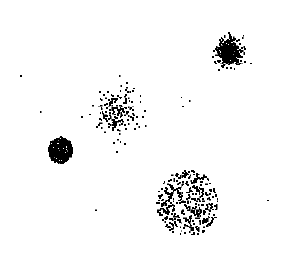
Anomaly Detection Schemes
General Steps
Build a profile of the “normal” behavior
Profile can be patterns or summary statistics for the overall population
Use the “normal” profile to detect anomalies
Anomalies are observations whose characteristics differ significantly from the normal profile
Types of anomaly detection schemes
Graphical & Statistical-based (today)
Distance-based
Nearest-neighbor based
Density based
Clustering based

Slide 9
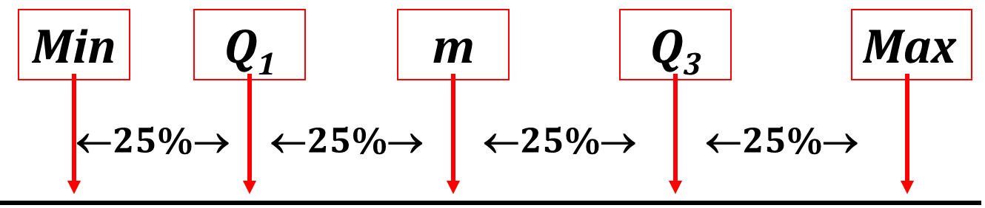
Box Plot
We need 5 numbers, called the 5 number summary:
1. minimum value
2. Q1
3. median
4. Q3
5. maximum value

Slide 10

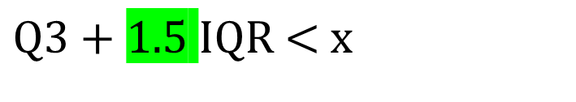
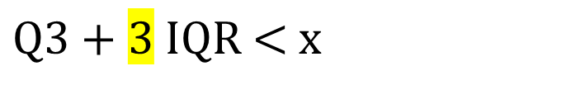

Outliers
Mild (used for boxplots)
Extreme
$$\text{x}\text{ < }\text{Q}\text{1 − 1.5 }\text{IQR}$$
$$\text{x}\text{ < }\text{Q}\text{1 − 3 }\text{IQR}$$
$$\text{Q}\text{3 + 1.}\text{5 }\text{IQR}\text{ < }\text{x}$$
$$\text{Q}\text{3 + 3 }\text{IQR}\text{ < }\text{x}$$

Slide 11
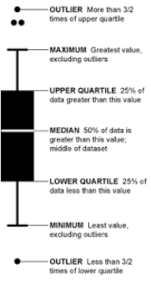
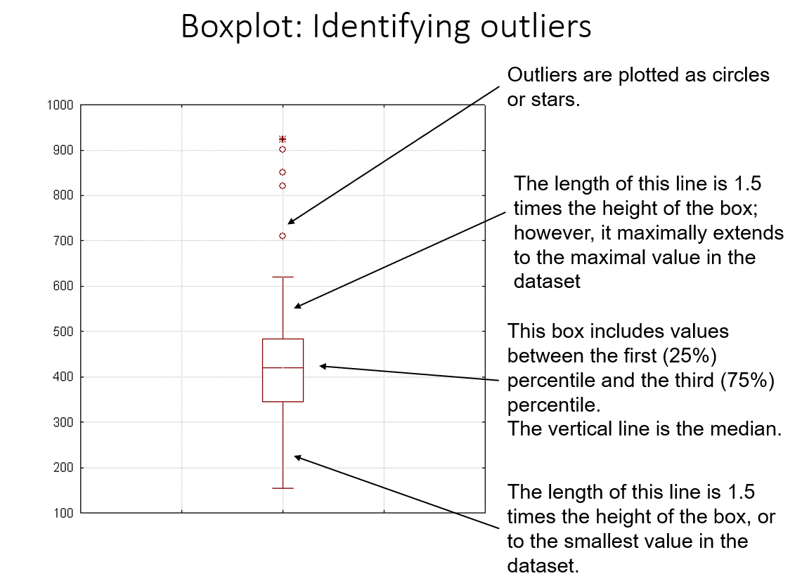
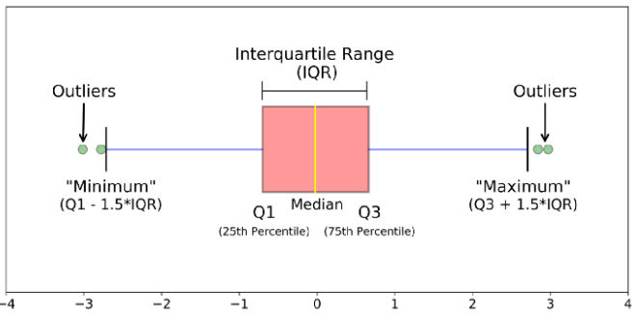
Boxplot
A box plot is used to illustrate the distribution, spread, and skewness (skewness) of numerical data through the display of quartiles.
Sources: https://en.wikipedia.org/wiki/Box_plot
and https://pandas.pydata.org/docs/reference/api/pandas.DataFrame.boxplot.html

Slide 12
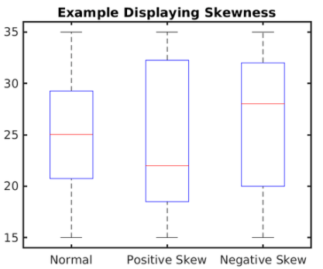
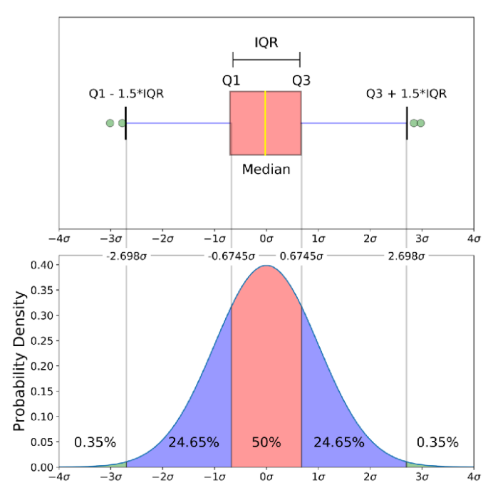
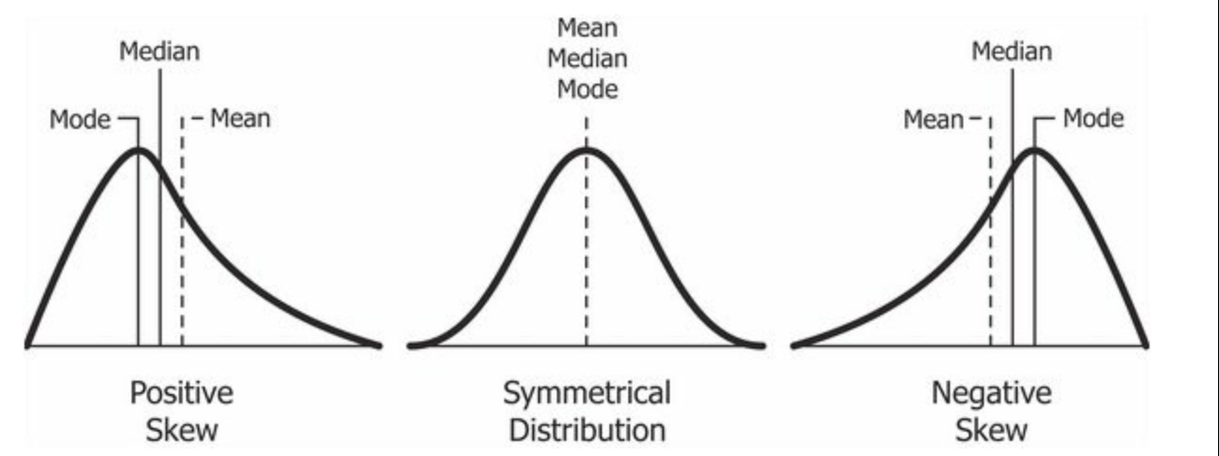
Boxplot On A Normal Distribution
Positive = right
Negative = left
Notes:
Right-Skewed Data (Positively Skewed)
In a right-skewed distribution, also known as positively skewed, the tail on the right side of the distribution is longer or more pronounced than the left side. This skewness indicates that there are a number of data points that are significantly higher than the rest of the data. In a right-skewed distribution:
Mean: The mean (average) is typically greater than the mode and median. This is because the mean is influenced by the high values in the tail, pulling it to the right.
Median: The median (the middle value when data is ordered) is closer to the mode but less than the mean. The median is less affected by extreme values.
Mode: The mode (the most frequent value) is the peak of the distribution and is located towards the left side of the graph, where the data is more concentrated.
Left-Skewed Data (Negatively Skewed)
Conversely, in a left-skewed distribution, also known as negatively skewed, the tail on the left side of the distribution is longer or more pronounced than the right side. This indicates that there are a number of data points that are significantly lower than the rest of the data. In a left-skewed distribution:
Mean: The mean is typically less than the median and mode, as it is influenced by the low values in the tail, pulling it to the left.
Median: The median is closer to the mode but greater than the mean. It's less influenced by the extreme low values.
Mode: The mode is the peak of the distribution and is located towards the right side of the graph, where the data is more concentrated.
If the data is right-skewed, it suggests that the bulk of the data is concentrated on the lower end, with a few higher values stretching the tail to the right. This might be seen in situations like household income, where most people earn below a certain threshold, but a few high incomes pull the mean higher.
If the data is left-skewed, it implies that most of the data is concentrated on the higher end, with a few lower values stretching the tail to the left. An example could be the age of retirement, where most people retire at an older age, but a few early retirements pull the mean lower.

Slide 13
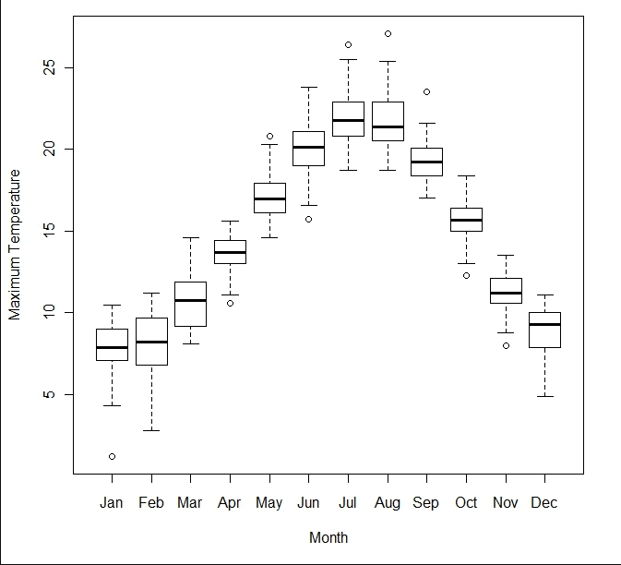
Boxplot Comparison

Slide 14
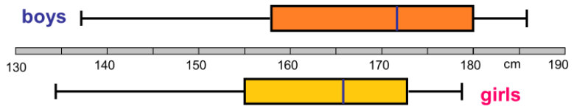
True or False?
Girls are on average taller?
Girls have a higher spread?
The shortest person is a girl?
The tallest person is a boy?
Both data sets are left skewd?
The average height of boys is 172 cm?
Half of the girls are between 155 and 170 cm?
The avg. height of boys is less than the median height?
Half of the boys are less than 172 cm?
Half the girls are taller than 165 cm?
¾ of the girls are taller than 155 cm?
¾ of the boys are lower than 180 cm?
The population displayed is ethnic Danish?

Slide 15
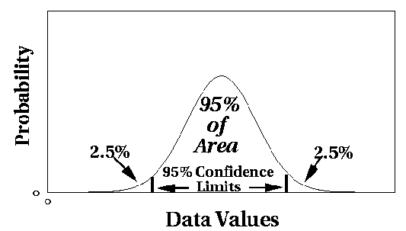
Outliers: Statistical Approaches
Assume a parametric model describing the distribution of the data (e.g., normal distribution)
Apply a statistical test that depends on
Data distribution
Parameter of distribution (e.g., mean, variance)
Number of expected outliers (confidence limit)

Slide 16
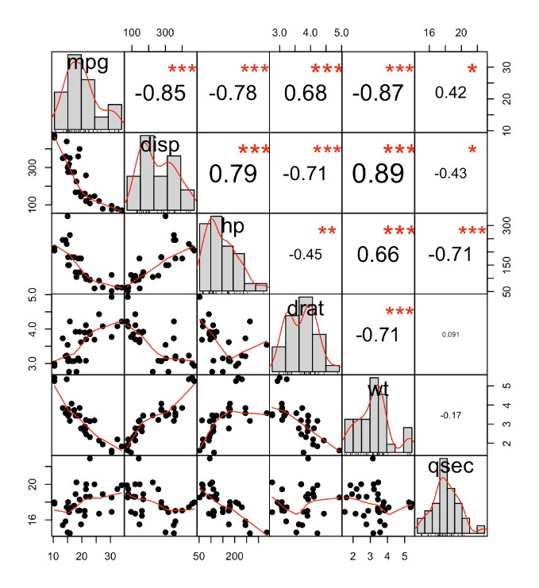
Correlation
Step 1: Select Data Step 2: Preprocess Data Step 3: Transform Data
Way to understand the relationship between multiple variables and attributes in your dataset
Using Correlation, you can get some insights such as:
¡ One or multiple attributes depend on another
¡ One or multiple attributes are associated with other attributes
Can help in predicting one attribute from another (great way to impute missing values)
Can (sometimes) indicate the presence of a causal relationship
http://www.sthda.com/english/wiki/correlation-analyses-in-r

Slide 17
Handling Missing Values
There are various strategies to handle or impute the missing values in a dataset.
Removal or Deletion of missing value
Impute missing values with Statistical way(Mean/Median/Mode)
Prediction Model (Regression and Classification Model)
Use sklearn Impute module (SimpleImputer , IterativeImputer, KNNImputer)
Imputation using Deep Learning Library - Datawig
Below are the Python Functions which are used to impute the missing values in a dataset.
Use Python fillna function
Use Interpolation method
Use python replace function

Slide 18
Imputation vs Removing Data
Missing not at Random (MNAR):
Also called nonignorable missingness
Missingness is not MCAR or MAR
Probability of missingness on Y depends on values of Y itself, e.g. people with higher income do not report income (even after controlling for other factors)
Missing at Random (MAR):
Also called ignorable missingness
Probability of missingness on Y does not depend on Y itself after controlling for other variables
Example: prob of missingness on income depends on age (older more likely to report than younger), but participants within each group equally likely to report income, i.e. prob of missingness on income unrelated within an age group
Missing Completely at Random (MCAR):
Reasons: Lab error, road accident, bad weather, residential move, family emergency, inadvertently skipping questions
Example: income and age, prob of missing data on income does not depend on income and age, i.e. participants of all ages likely to report income
Notes:
A practical example of Missing Not at Random (MNAR) involves a scenario in employee satisfaction surveys within a company. Suppose the company distributes a survey to all employees to gauge their satisfaction with their work environment, management, and overall job satisfaction. The survey includes a range of questions, from job role satisfaction to personal development opportunities.
In this case, it's observed that a significant portion of the survey responses are missing from employees who later resign or are known to be dissatisfied with their jobs. The absence of these responses is not just random or due to observable factors; rather, it's inherently linked to the unobserved dissatisfaction levels of these employees. They might choose not to complete the survey because they are disengaged, fear retaliation, or believe that expressing their dissatisfaction will not lead to any constructive change.
This scenario exemplifies Missing Not at Random (MNAR) because the reason for the missing data (the dissatisfaction leading to resignation) is related to the missing data itself (the unreported dissatisfaction in the survey). The missingness is a result of the very issue being measured, which makes it challenging to analyze the data without bias. Standard statistical methods to handle missing data might not be sufficient, as they typically assume the data is Missing Completely at Random (MCAR) or Missing at Random (MAR), and special techniques or assumptions may be needed to address the bias introduced by MNAR data.
A practical example of Missing at Random (MAR) can be illustrated in the context of a survey conducted on exercise habits among a population. Imagine a survey that asks various questions, including one about the frequency of exercise and another about the respondent's current health status (e.g., any chronic illnesses).
In this scenario, it might be observed that responses to the exercise frequency question are more likely to be missing for individuals who have reported having a chronic illness. The reason could be that individuals with chronic illnesses might be less inclined or able to exercise regularly, and therefore might choose not to answer the question about exercise frequency, feeling it's not applicable or too sensitive to them.
The key point here is that the missingness of the exercise frequency data is not random; it's related to another variable in the dataset (the reported health status). However, if among those who have a chronic illness, the likelihood of missing the exercise frequency data is not related to the actual exercise frequency (but rather to their feelings about its relevance or sensitivity), then the data can be considered Missing at Random (MAR).
In MAR, the cause of the missing data is related to observed data (in this case, the reported health status) and not to the missing data itself (the actual exercise frequency). This means that with the proper statistical techniques that account for the observed data (health status), we can make unbiased inferences about the exercise habits of the entire surveyed population, despite the missing data.
A practical example of Missing Completely at Random (MCAR) can be seen in a situation where a researcher is collecting data on the dietary habits of a group of people through an online survey. The survey includes various questions about daily intake of fruits, vegetables, proteins, etc.
If the online survey system experiences a technical glitch that causes responses to be randomly lost, with no discernible pattern to which responses are lost or which participants are affected, then the missing data can be considered MCAR. For example, due to this glitch, some responses from various questions across the survey might not be recorded, but this loss of data is not related to the participant's dietary habits, their demographics, or any other measured variable.
In the MCAR scenario, the reason for the missing data has nothing to do with the data itself or with any of the other variables being measured. It's purely random - like accidentally dropping and losing a handful of completed survey forms, or a computer error that randomly deletes some survey entries without regard to the content of those entries. Because the missingness is completely random, the analysis of the dataset, with appropriate handling of the missing data, can still lead to unbiased estimates of the parameters of interest.

Slide 19
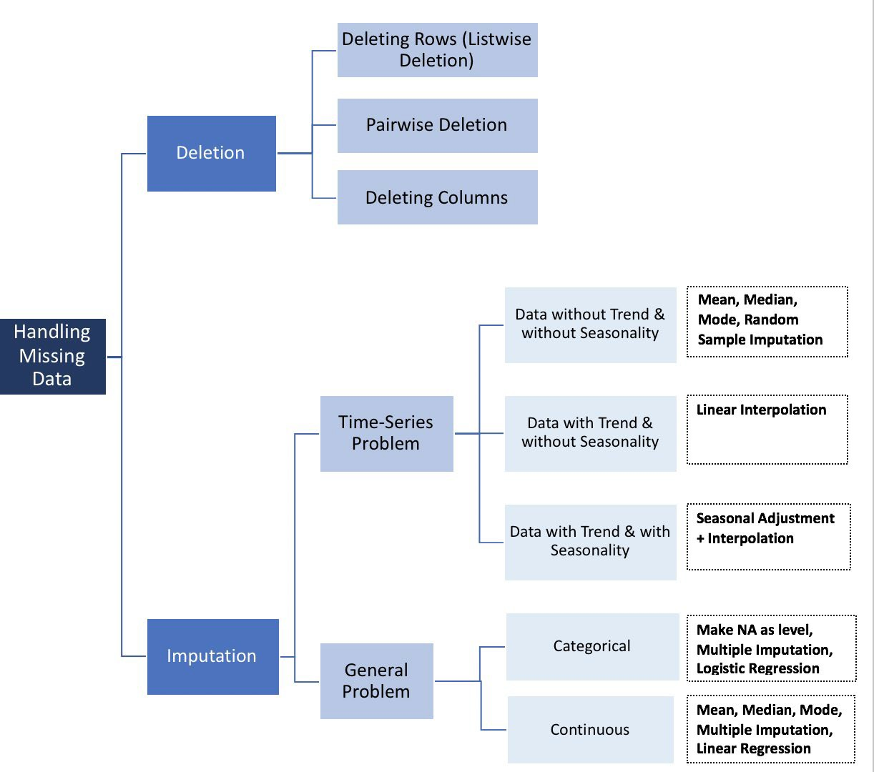
How to Handle Missing Data
Step 1: Select Data Step 2: Preprocess Data Step 3: Transform Data
There is NO good way to deal with missing data!
Different solutions for data imputation depending on the kind of problem — Time series Analysis, ML, Regression etc.
No general solution
https://towardsdatascience.com/how-to-handle-missing-data-8646b18db0d4

Slide 20
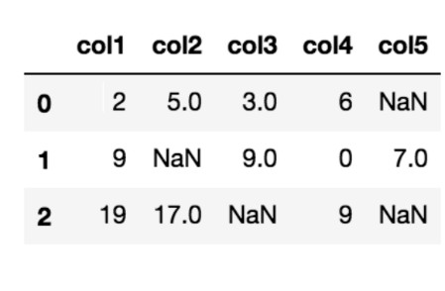
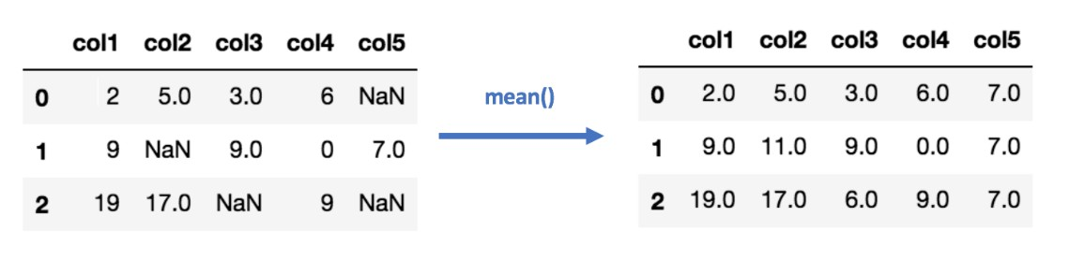
Data Imputation (Mean/Median) Values
Step 1: Select Data Step 2: Preprocess Data Step 3: Transform Data
Calculating the mean/median of the non-missing values in a column
Pros | Cons
Easy and fast | Doesn’t factor the correlations between features. It only works on the column level
Works well with small numerical datasets | Will give poor results on encoded categorical features (do NOT use it on categorical features)
 | Not very accurate
 | Doesn’t account for the uncertainty in the imputations

Slide 21
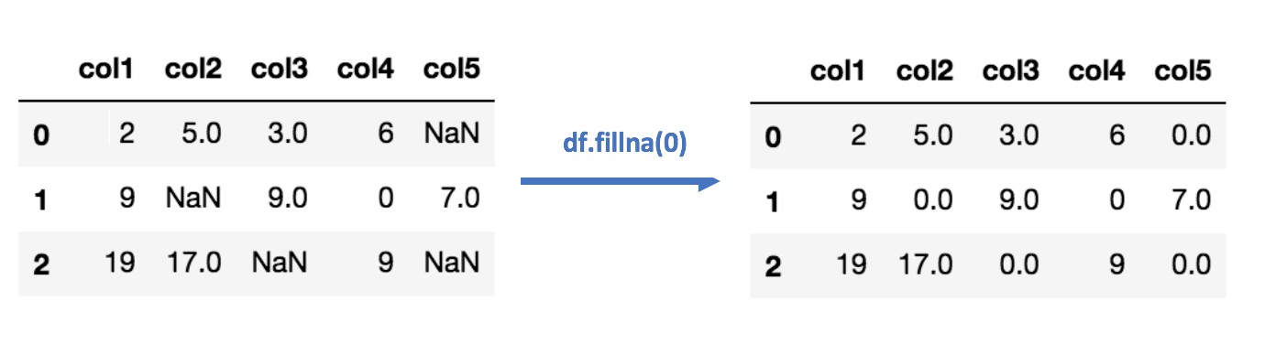
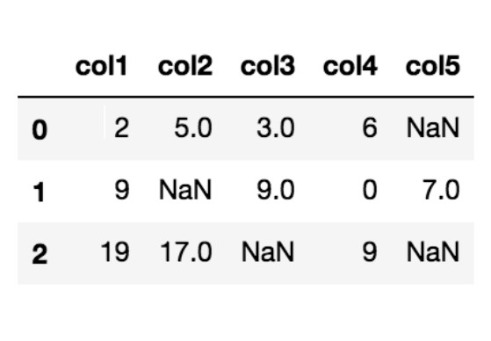
Data Imputation
(Most Frequent) or (Zero/Constant) Values
Step 1: Select Data Step 2: Preprocess Data Step 3: Transform Data
Most Frequent statistical strategy to impute missing values
Replacing missing data with the most frequent values within each column
Pros | Cons
Works well with categorical features | It also doesn’t factor the correlations between features
 | It can introduce bias in the data
Zero or Constant imputation replaces the missing values with either zero or any constant value you specify

Slide 22
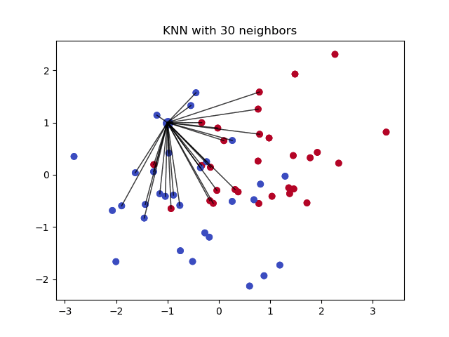
Data Imputation k-NN
Step 1: Select Data Step 2: Preprocess Data Step 3: Transform Data
Algorithm uses ‘feature similarity’ to predict the values of any new data points
New point is assigned a value based on how closely it resembles the points in the training set
Pros | Cons
Can be much more accurate than the mean, median or most frequent imputation methods (It depends on the dataset) | Computationally expensive. KNN works by storing the whole training dataset in memory
 | K-NN is quite sensitive to outliers in the data (unlike SVM)

Slide 23
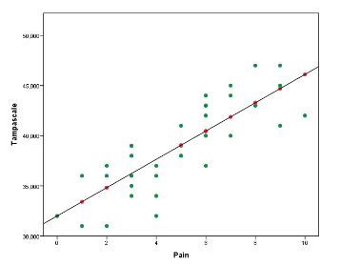
Data Imputation Regression
Step 1: Select Data Step 2: Preprocess Data Step 3: Transform Data
With regression imputation the information of other variables is used to predict the missing values in a variable by using a regression model.
Commonly, first the regression model is estimated in the observed data and subsequently using the regression weights the missing values are predicted and replaced.
Pros | Cons
Can be much more accurate than the mean, median or most frequent imputation methods (It depends on the dataset) | Computationally expensive. Regression works by storing the whole training dataset in memory
 | Regression is also quite sensitive to outliers in the data

Slide 24
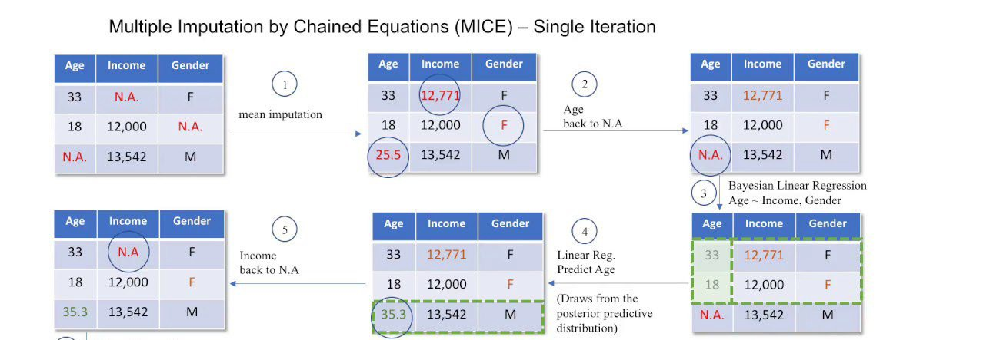
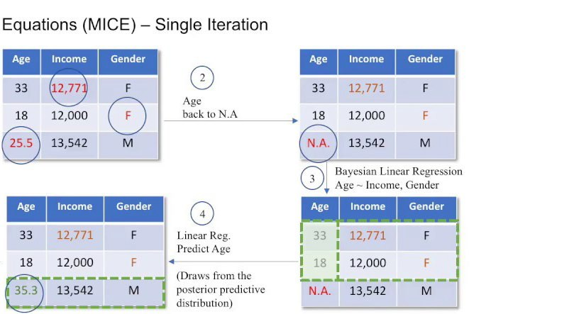
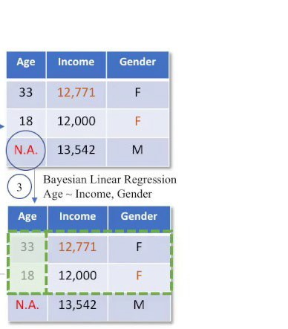
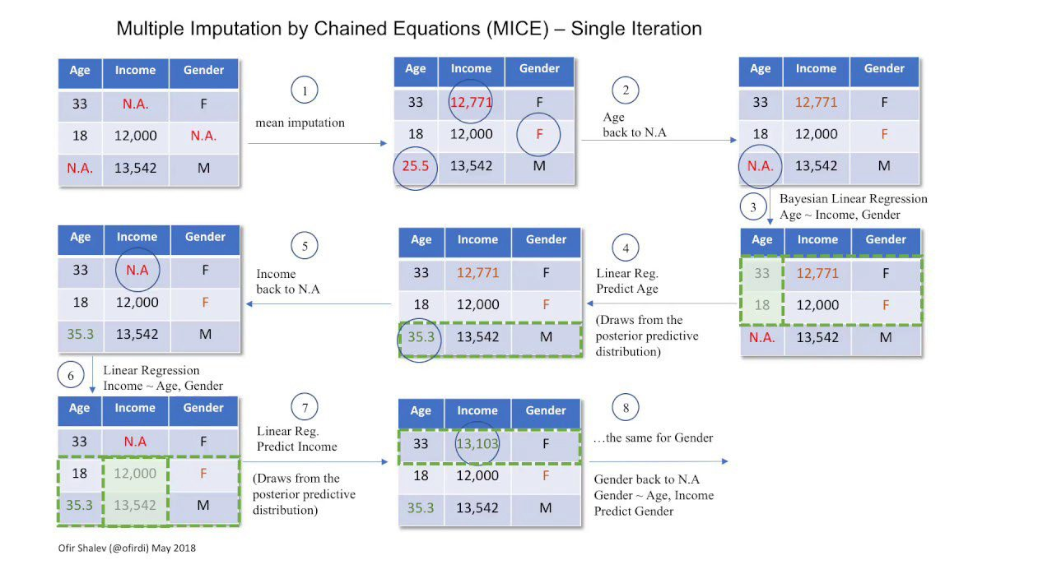
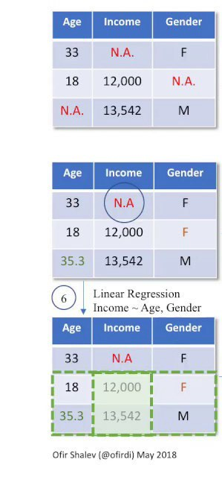
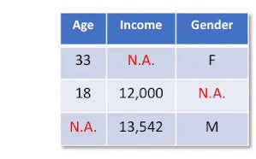
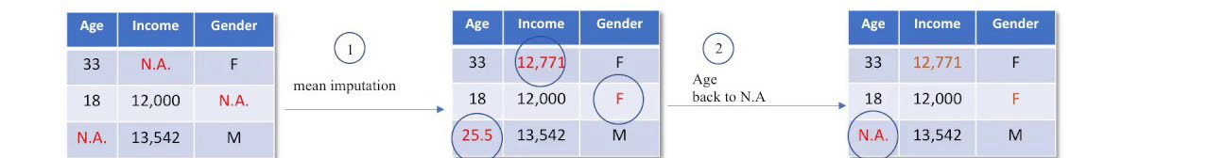
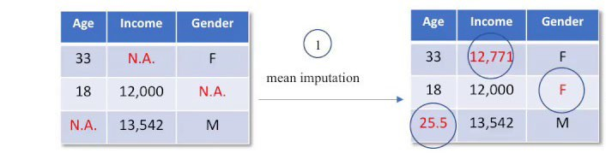
Data Imputation Multivariate Imputation
Step 1: Select Data Step 2: Preprocess Data Step 3: Transform Data
Filling the missing data multiple times
Multiple Imputations (MIs) are much better than a single imputation as it measures the uncertainty of the missing values in a better way
Chained equations approach is also very flexible and can handle different variables of different data types
https://www.youtube.com/watch?v=zX-pacwVyvU

Slide 25
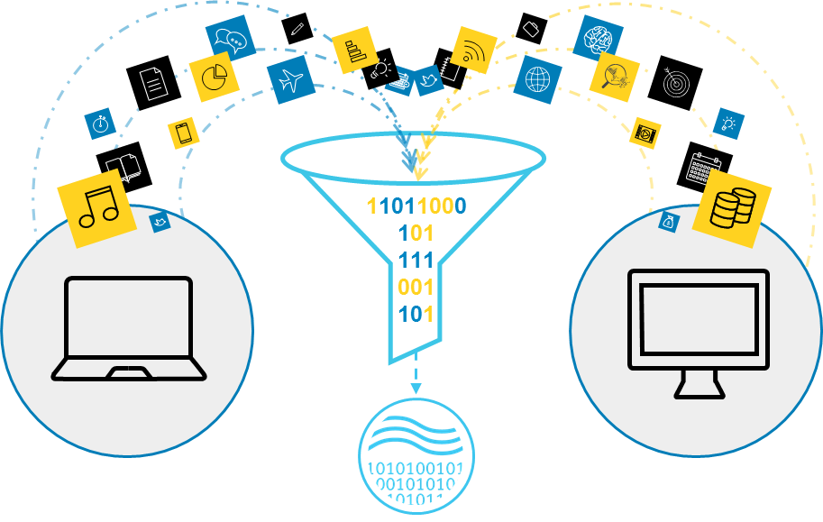
Transform Data
Step 1: Select Data Step 2: Preprocess Data Step 3: Transform Data
Scaling: The preprocessed data may contain attributes with a mixtures of scales for various quantities. Many machine learning methods like data attributes to have the same scale
Decomposition: There may be features that represent a complex concept that may be more useful to a machine learning method when split into the constituent parts
¡ Example → Date
Aggregation: There may be features that can be aggregated into a single feature
https://blog.dellemc.com/en-us/digital-transformation-just-got-easier-with-analytic- insights/

Slide 26
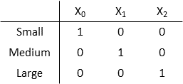
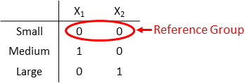
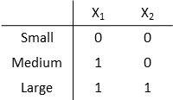
Dummy Variables
Step 1: Select Data Step 2: Preprocess Data Step 3: Transform Data
Also known as One-Hot Encoding!
Transforming categorical attribute to numerical attribute
Each attribute will have value either 0 or 1
Full Dummy Variables: Represent n categories using n dummy variables, one variable for each level
Dummy Variables with Reference Group: Represent
the categorical variable with n categories using n-1
dummy variables
Dummy Variables for Ordered Categorical Variable with Reference Group: Assume mathematical
ordering Small < Medium < Large. To indicate the
ordering, use more 1s for higher categories
https://de.mathworks.com/help/stats/dummy-indicator-variables.html

Slide 27
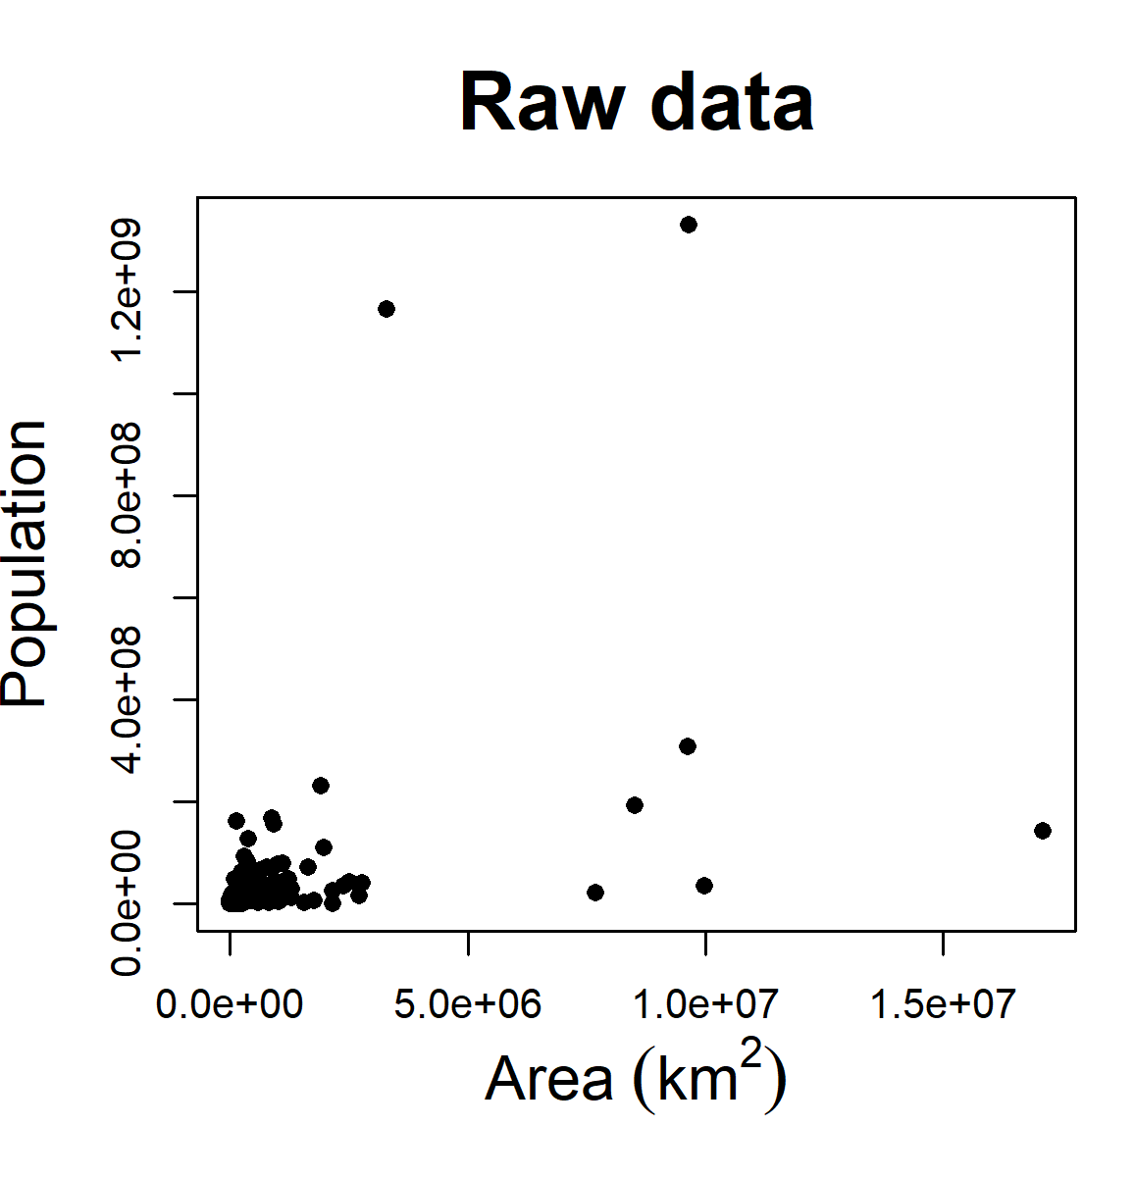
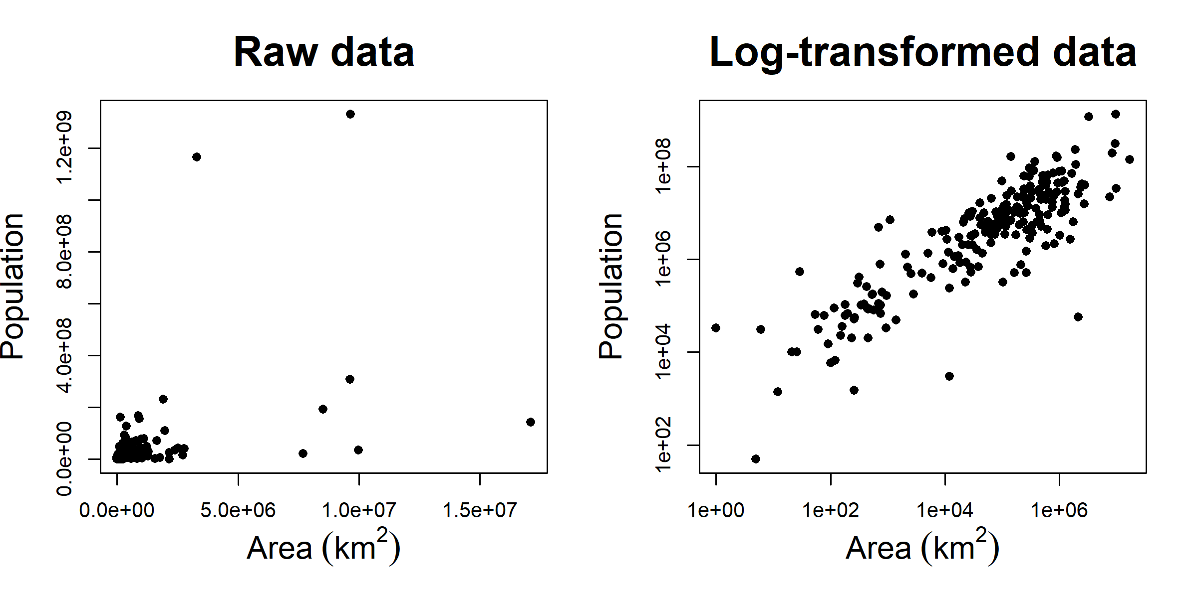
Transformed Attributes
Step 1: Select Data Step 2: Preprocess Data Step 3: Transform Data
Data transformation changes relative differences among individual values
Types of transformation:
¡ Linear: By adding constant or multiplying by constant
¡ Non-linear: log-transformation, square-root transformation etc.
https://www.davidzeleny.net/anadat-r/doku.php/en:data_preparation

Slide 28
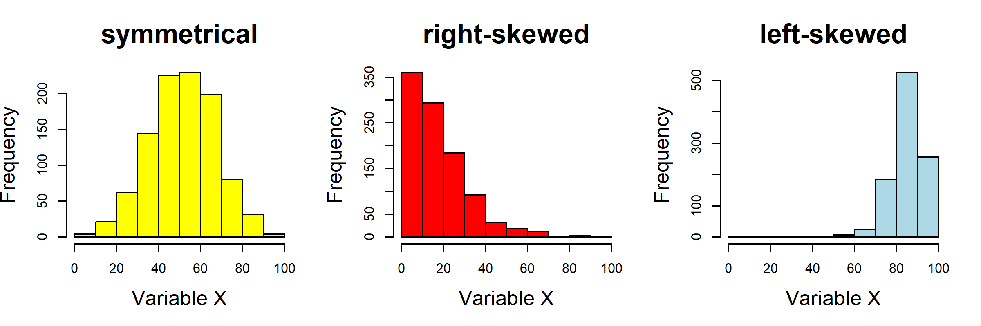
Transformed Attributes
Step 1: Select Data Step 2: Preprocess Data Step 3: Transform Data
log transformation is suitable for strongly right-skewed data, sqrt transformation is suitable for slightly right-skewed data
https://www.kaggle.com/code/aimack/how-to-handle-skewed-distribution

Slide 29

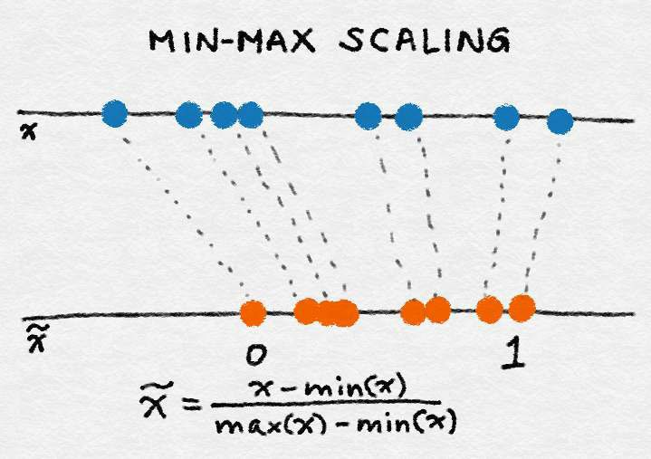
Min-Max Scaling
Step 1: Select Data Step 2: Preprocess Data Step 3: Transform Data
Let x be an individual feature value (i.e., a value of the feature in some data point) and let min(x) and max(x), respectively, be the minimum and maximum values of this feature over the entire dataset
Min-max scaling squeezes (or stretches) all feature values to be within the range of [0, 1]
Feature Engineering for Machine Learning Principles and Techniques for Data Scientists Alice Zheng and Amanda Casari, O’Reilly, 2018

Slide 30

Mean normalization
Step 1: Select Data Step 2: Preprocess Data Step 3: Transform Data
where x is an original value, x' is the normalized value. There is another form of the means normalization which divides by the standard deviation which is also called standardization.

Slide 31
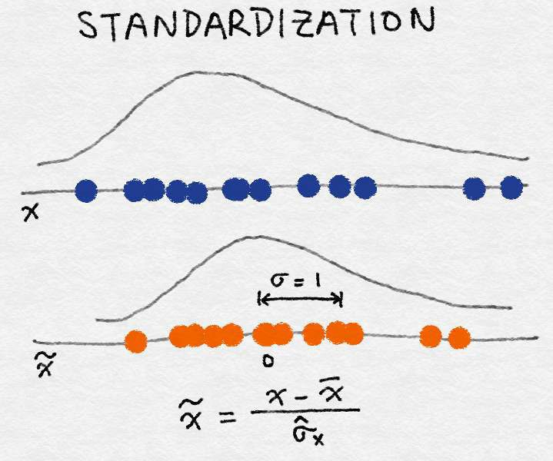

Standardization (Variance Scaling)
Step 1: Select Data Step 2: Preprocess Data Step 3: Transform Data
It subtracts off the mean of the feature (over all data points) and divides by the variance
It can also be called variance scaling
resulting scaled feature has a mean of 0 and a variance of 1
If the original feature has a Gaussian distribution, then the scaled feature does too
Feature Engineering for Machine Learning Principles and Techniques for Data Scientists Alice Zheng and Amanda Casari, O’Reilly, 2018

Slide 32
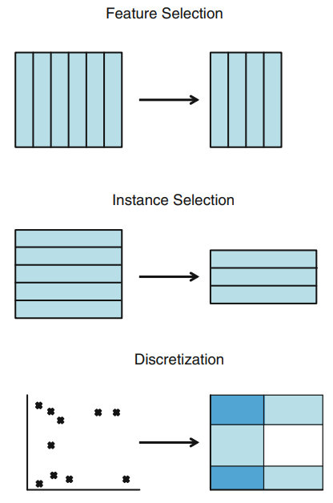
Data Reduction
Step 1: Select Data Step 2: Preprocess Data Step 3: Transform Data
How do I reduce the dimensionality of data? → Feature Selection (FS)
How do I remove redundant and/or conflictive examples? → Instance Selection (IS) How do I simplify the domain of an attribute? → Discretization/binning
How do I fill in gaps in data? → Feature Extraction and/or Instance Generation

Slide 33
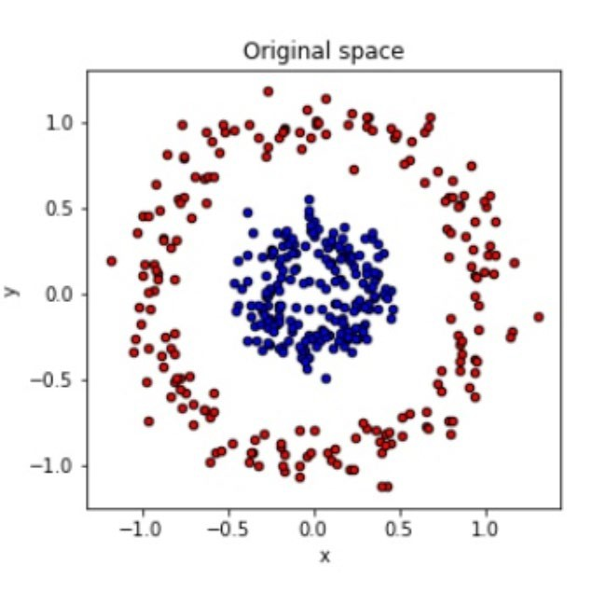
Feature Engineering
Example: Coordinate Transformation
Step 1: Select Data Step 2: Preprocess Data Step 3: Transform Data
Not possible to seperate using linear classifier

Slide 34
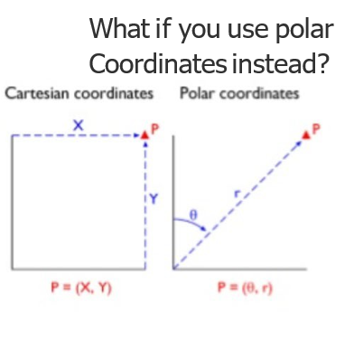
Feature Engineering
Example: Coordinate Transformation
Step 1: Select Data Step 2: Preprocess Data Step 3: Transform Data

Slide 35
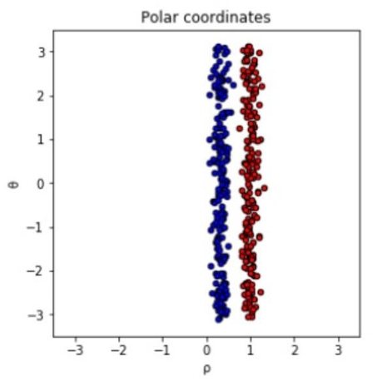
Feature Engineering
Example: Coordinate Transformation
Step 1: Select Data Step 2: Preprocess Data Step 3: Transform Data

Slide 36
Aspects of Feature Engineering
Step 1: Select Data Step 2: Preprocess Data Step 3: Transform Data
Feature Engineering
Feature Selection | Most useful and relevant features are selected from the available data
Feature Extraction | Existing features are combined to develop more useful ones
Feature Addition | New features are created by gathering new data
Feature Filtering | Filter out irrelevant features to make the modeling step easy

Slide 37
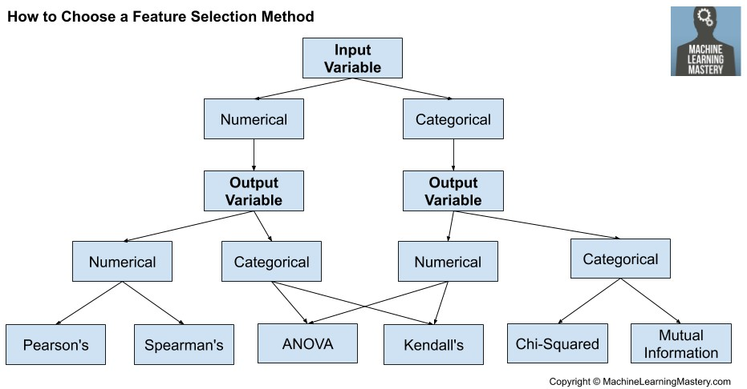
Feature Selection
Step 1: Select Data Step 2: Preprocess Data Step 3: Transform Data
Process where you automatically select those features in your data that contribute most to the prediction variable or output in which you are interested
Having irrelevant features in your data can decrease the accuracy of many models, especially linear algorithms like linear and logistic regression
https://machinelearningmastery.com/feature-selection-with-real-and-categorical-data

Slide 38
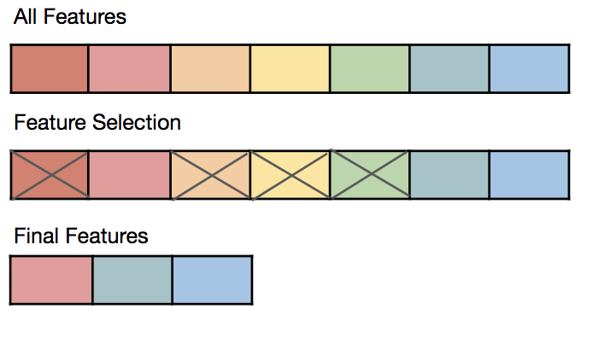
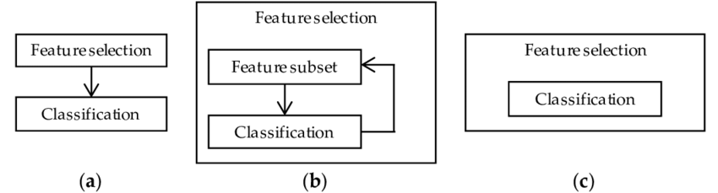
Feature Selection
Step 1: Select Data Step 2: Preprocess Data Step 3: Transform Data
Three benefits of performing feature selection before modeling your data are:
¡ Reduces Overfitting: Less redundant data means less opportunity to make decisions based on noise
¡ Improves Accuracy: Less misleading data means modeling accuracy improves
¡ Reduces Training Time: Less data means that algorithms train faster
https://quantdare.com/what-is-the-difference-between-feature-extraction-and-feature-selection/
https://towardsdatascience.com/featur e-selection-techniques-1bfab5fe0784

Slide 39
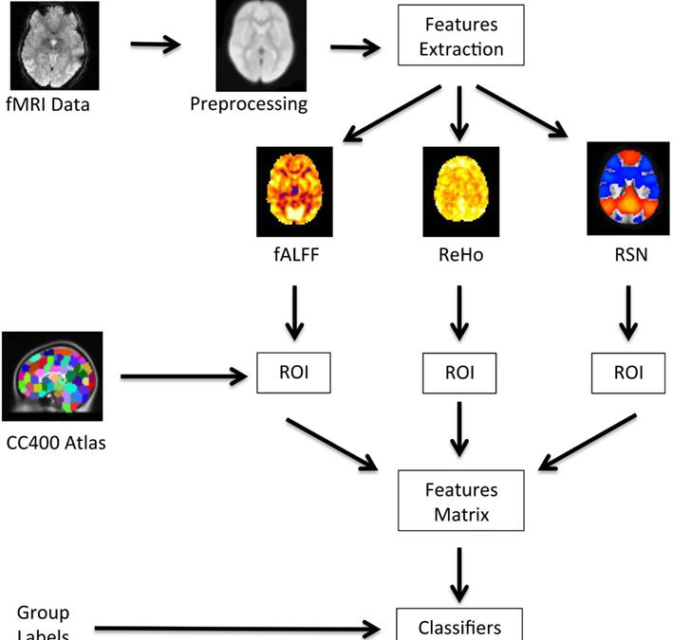
Feature Extraction
Step 1: Select Data Step 2: Preprocess Data Step 3: Transform Data
Aims to reduce the number of features in a dataset by creating new features from the existing ones (and then discarding the original features)
New reduced set of features should then be able to summarize most of the information contained in the original set
Create some interaction (e.g., multiply or divide) between each pair of variables → lengthy process
Deep feature synthesis (DFS) is an algorithm which enables you to quickly create new variables with varying depth

Slide 40
Resources
Data Cleaning
Feature Engineering
Imbalanced dataset handling

